Slide 1
Links to resources:
Bash:
https://programminghistorian.org/en/lessons/intro-to-bash
http://linuxcommand.org/lc3_learning_the_shell.php
Bash “cheat sheets”:
https://www.educative.io/blog/bash-shell-command-cheat-sheet
https://ss64.com/bash/
https://courses.cs.washington.edu/courses/cse391/16sp/bash.html
Rosetta:
https://www.rosettacommons.org/
“Documentation & Support” > “User Guide”
“Rosetta Basics”
“Rosetta Scripting Interfaces” > “RosettaScripts”
“Rosetta Tutorials” <- HW (Just read the tutorials, don’t do them. Start at #5.)

Slide 2
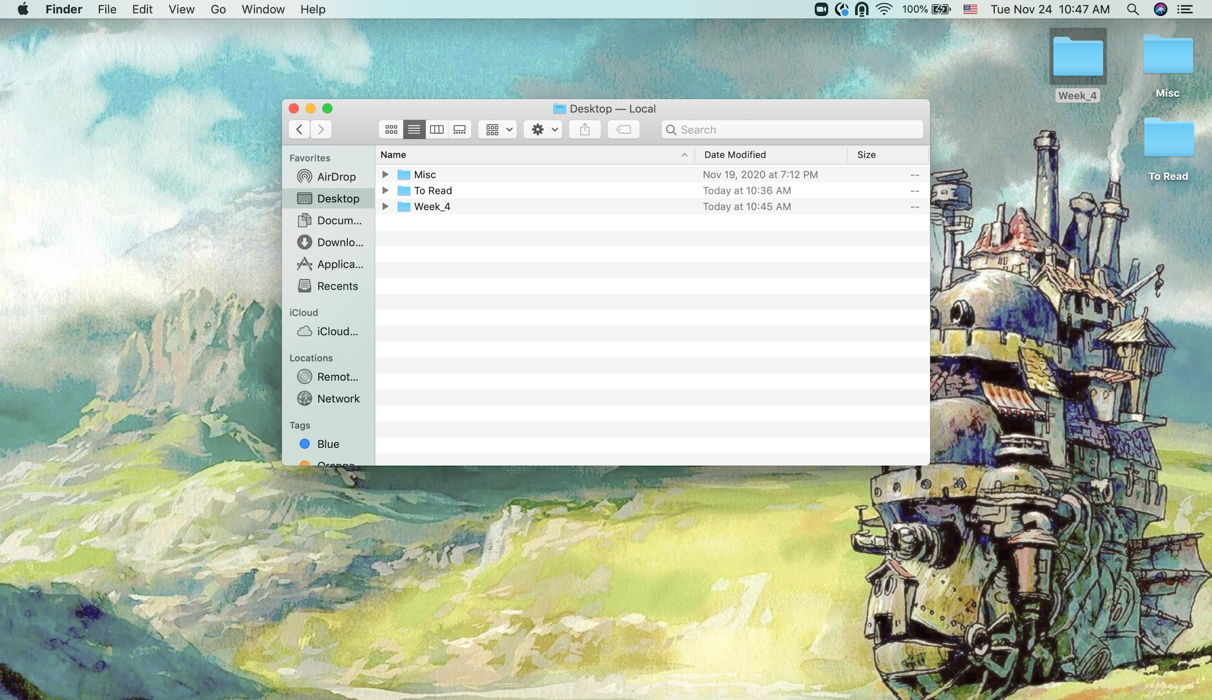
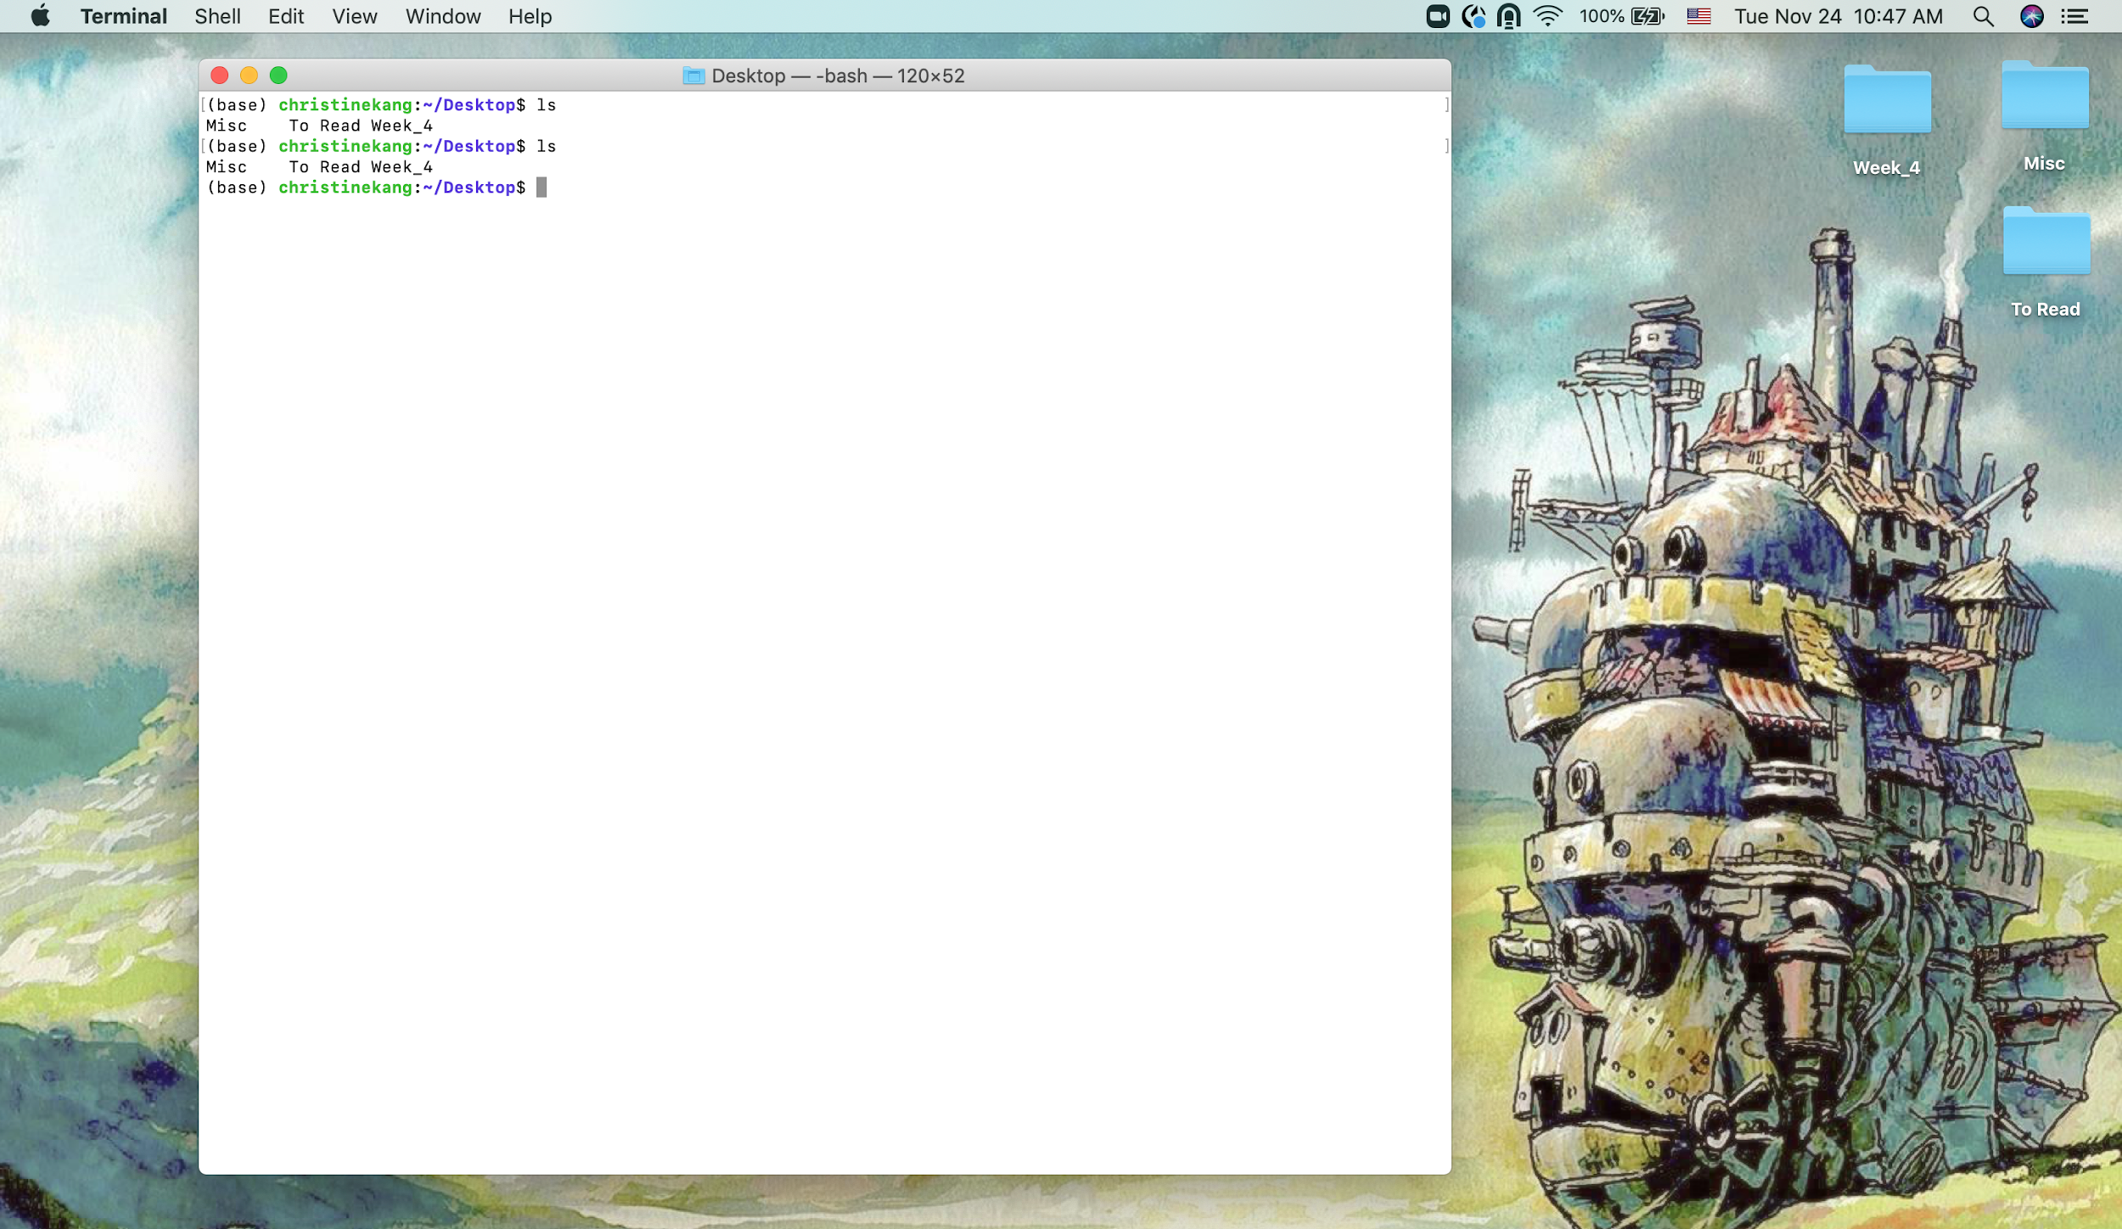
Gist of Command Line:
Graphical User Interface (GUI, “gooey”)
Designed to be interacted with using click and drag.
Easy to use.
Command Line
Designed to be interacted with using text “commands”, bash.
Hardest part of this is learning what the commands are. Easy to use once you learn those.

Slide 3
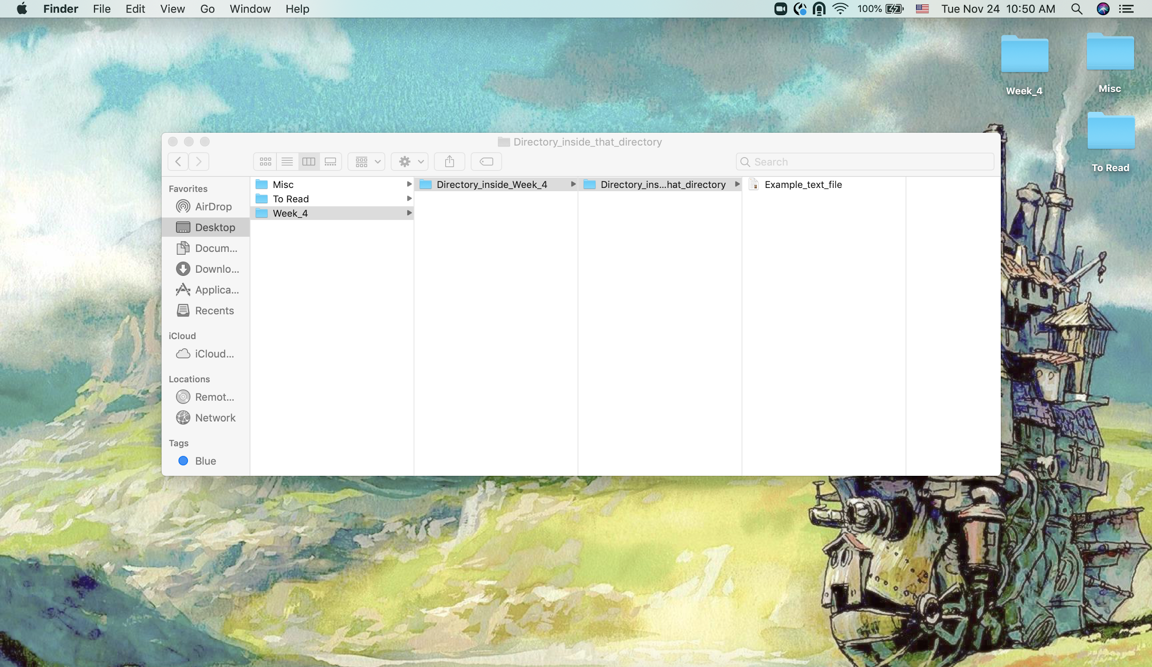
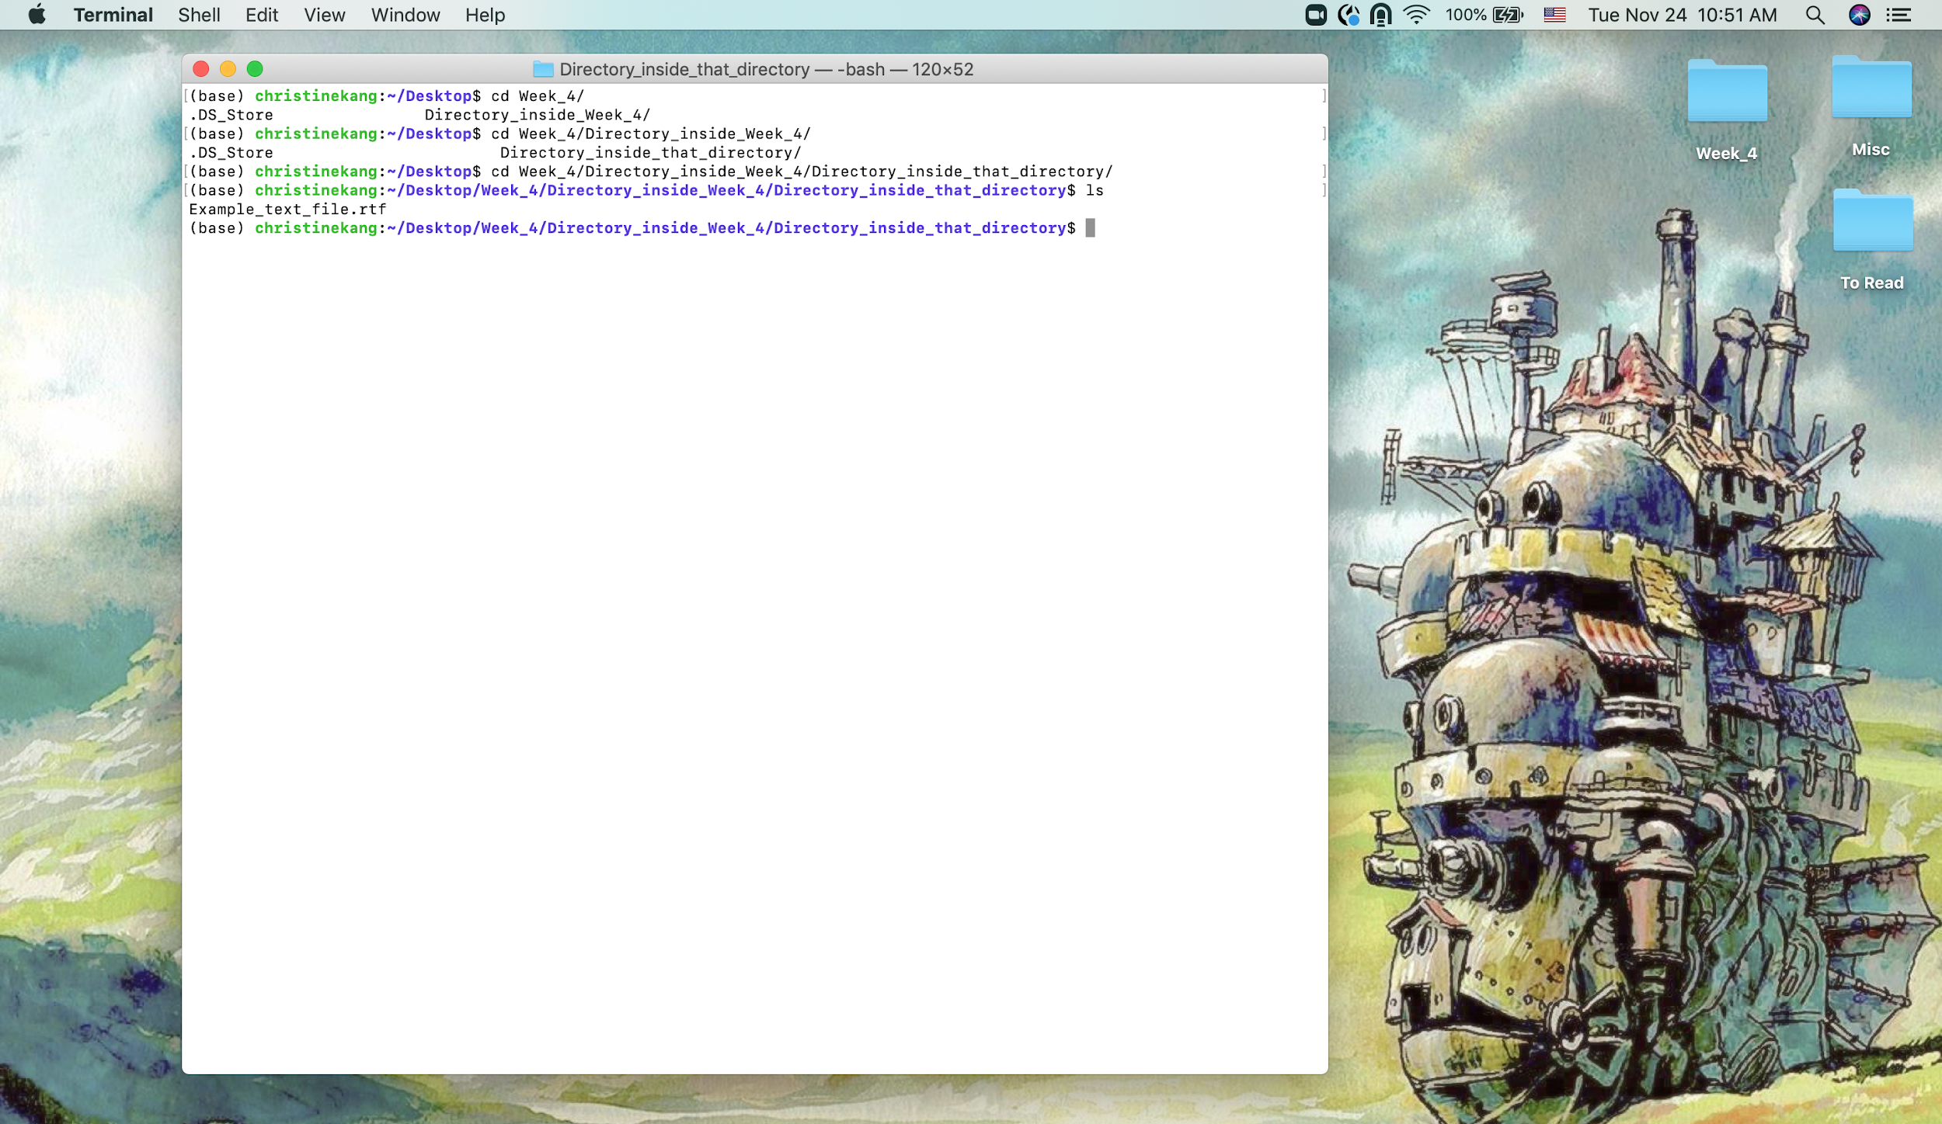
Gist of Directory Organization, etc.:
Think of directory structure like a tree.
Your “home” directory is the trunk, and each directory inside of it are its branches, then twigs on those branches, then leaves on those twigs.

Slide 4
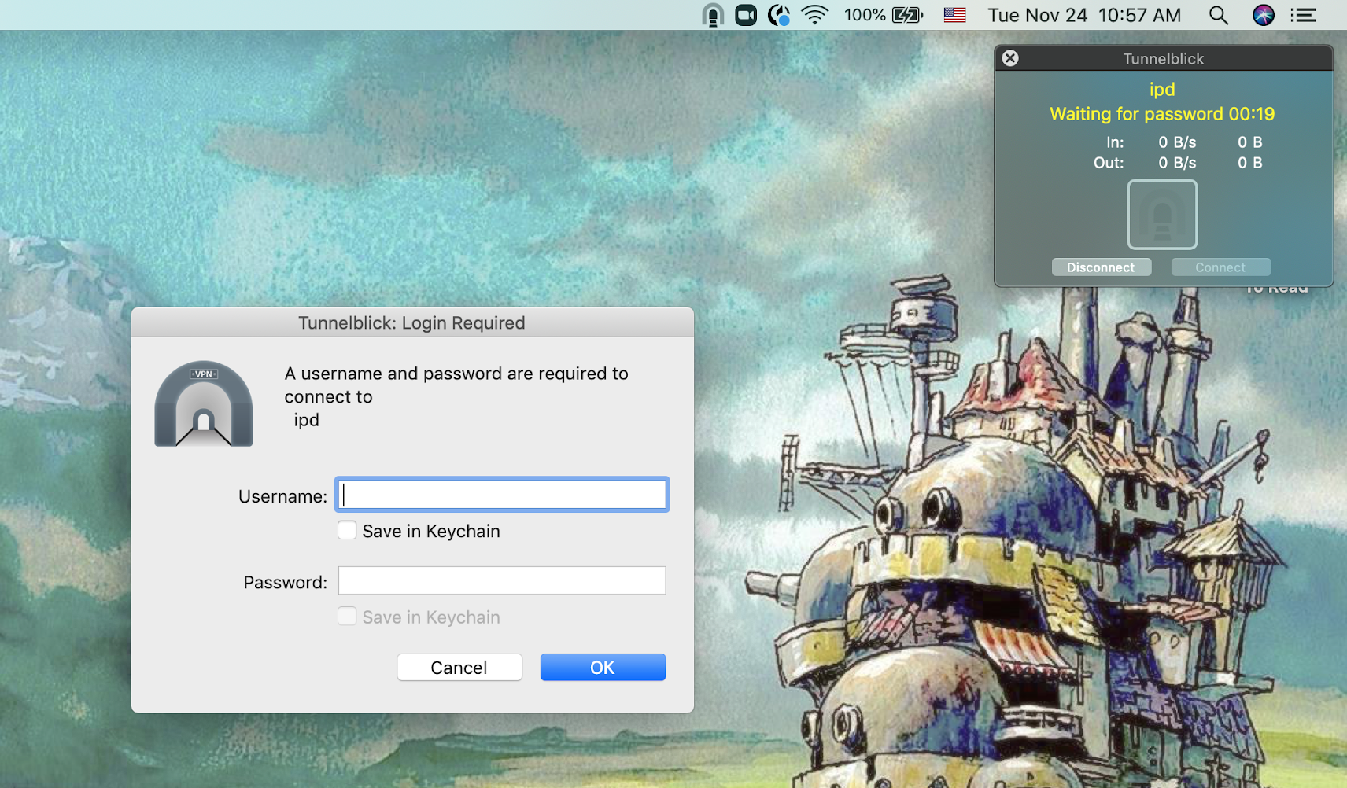
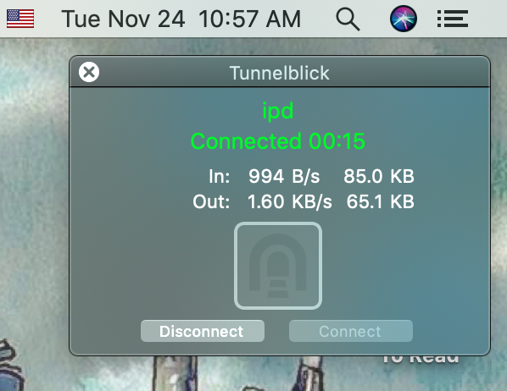
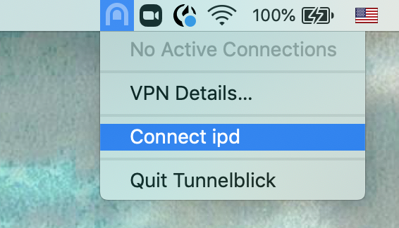
Logging into the DIGs for the first time - VPN
✅
The DIGs is a shared compute cluster that many people at the IPD use to do their computational work. Please be very careful navigating around on it.

Slide 5
Homework
Office hours - please email one of us or post to the Mattermost channel to get help.
Read through (to gain exposure): https://www.rosettacommons.org/demos/latest/Home#tutorials
As many as you have time for, at minimum, please read #5, #13, and #16.
No need to read #1-4, that’s just info on downloading Rosetta. You don’t need to do that as we have a copy of Rosetta available on the DIGs.
Familiarize yourself with the IPD wiki (click around the wiki - need to be connected to the VPN):
https://wiki.ipd.uw.edu/it/welcome
https://wiki.ipd.uw.edu/it/digs
https://wiki.ipd.uw.edu/it
Watch the videos Alena suggested on the Mattermost: https://www.ipd.uw.edu/learn/
IPD TV Episode 2 and IPD TV Episode 3 (This one is more advanced.)

Slide 6
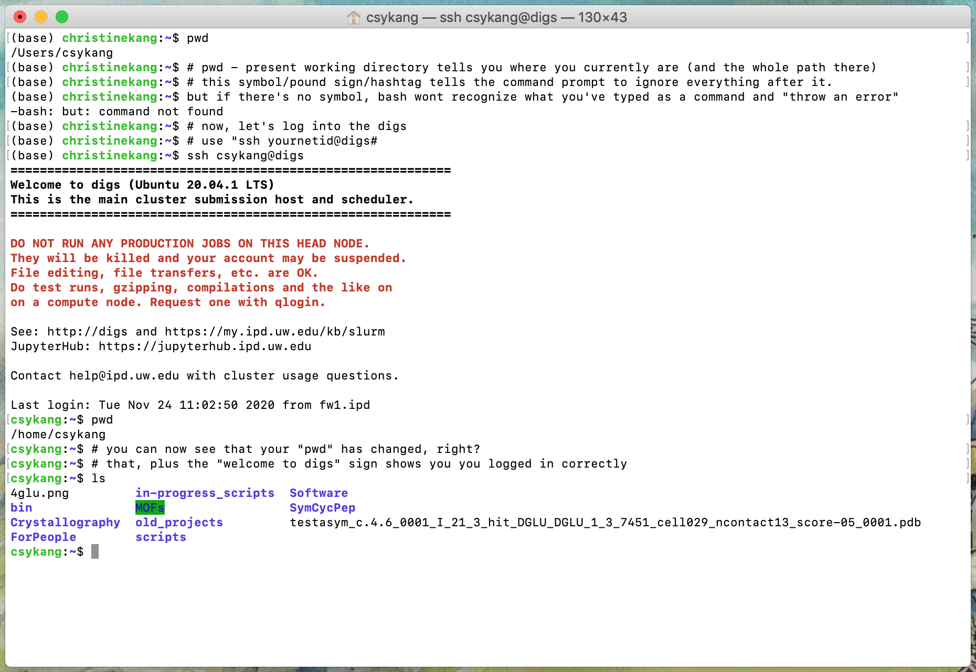
Logging into the DIGs for the first time.
I forgot to qlogin here (bad), but you need to remember to qlogin before you start doing other things.

Slide 7
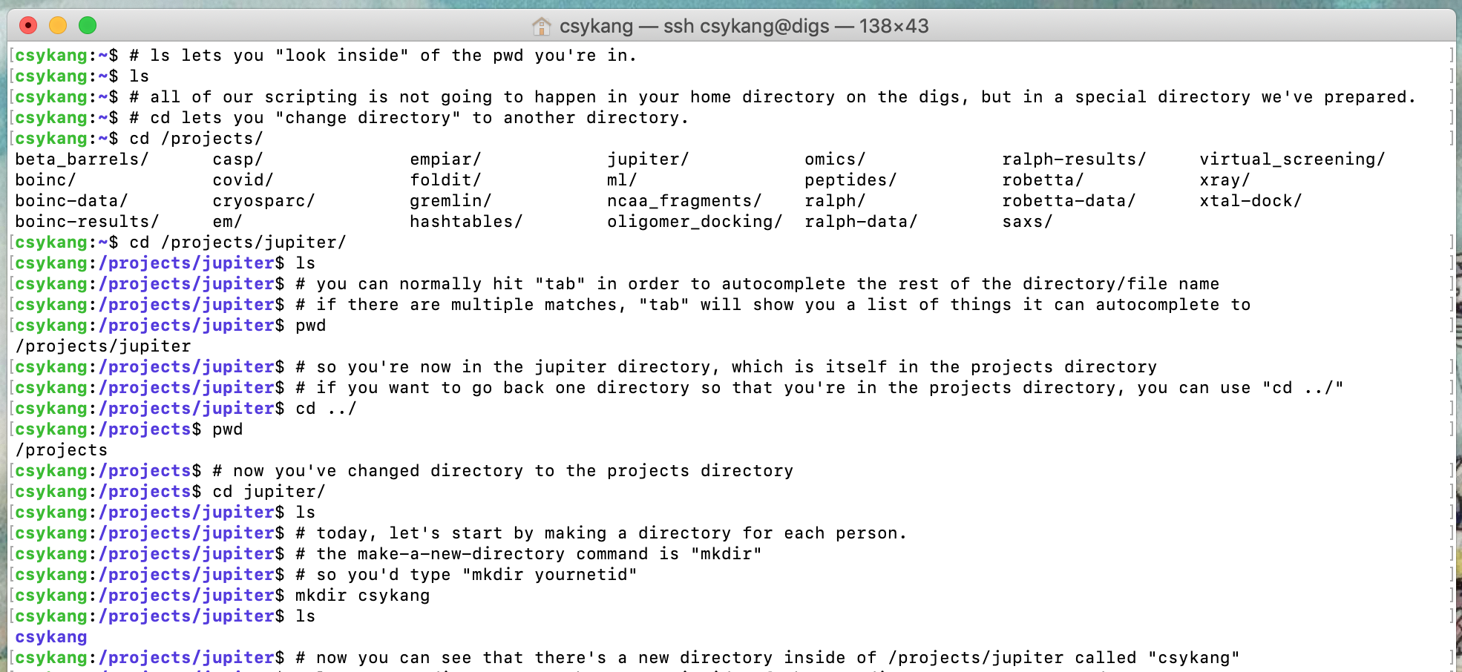
Navigating from your home directory to /projects

Slide 8
Week 5 Starts Here

Slide 9
Logging into the DIGs for the first time.
In the command line (Terminal, iTerm, etc.), type:
ssh yournetid@digs
hit [Enter/Return]
qlogin
^This is how you get an interactive node (So you don’t slow down other people’s ability to do their work while you do yours.)
When you’re done, make sure you:
exit
To exit your interactive node (qlogin).
Then:
exit
again, to exit the DIGs.
Example:
ssh csykang@digs
[Enter/Return]

Slide 10
Before we get into RosettaScripts Basics...
How was the homework?
Did you get a chance to watch the videos Alena suggested on the Mattermost? (https://www.ipd.uw.edu/learn/)
IPD TV Episode 2 & IPD TV Episode 3
What did you think about the Rosetta tutorials? Navigating the wiki?
What did you think?
What was confusing?
What made sense?

Slide 11

RosettaScripts 101
RosettaScripts is a scripting interface for the Rosetta Software Suite that uses XML schema.
If you have seem HTML script before, it’s very similar.
This scripting interface (and others like PyRosetta, a Python interface) is necessary because most of Rosetta today is written in C++ (and most people, including me, don’t want to have to learn how to code in C++ in order to do simple things in Rosetta).
We have it very lucky today. In the 90s, Rosetta used to be written in FORTRAN, which was used to program some of the first rockets into space.

Slide 12
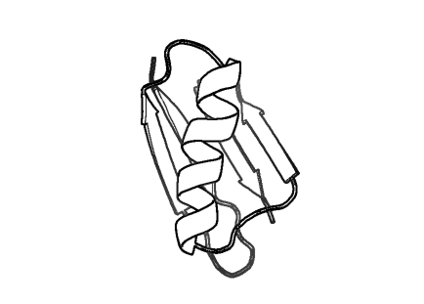

RosettaScripts has a one-in, one-out policy
Input “pose”
(.pdb)
Output “pose”
(.pdb)
RosettaScripts is used to tell the Rosetta Software to do something to the pose.

Slide 13
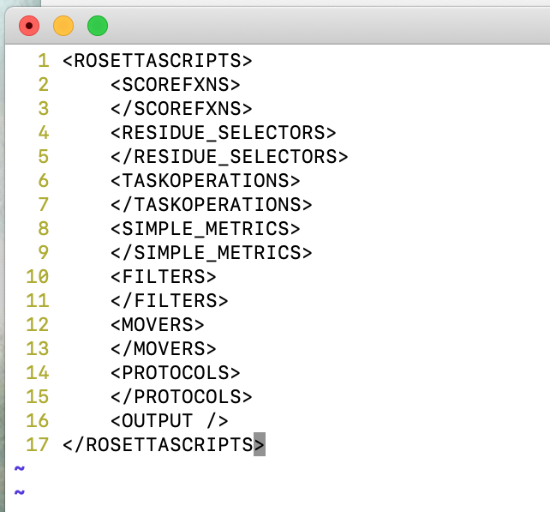
RosettaScripts
You’ve read about the scorefxn “score function” in the Alford paper. It’s how Rosetta can calculate how good a protein is, and it’s likeliness to fold into the shape we want/the same shape as the computer model.
Residue selectors let us do specific actions to specific amino acid residues (based on amino acid name, residue number, location in the protein, etc.)
Movers control the specific actions we do to the pose, or to specific residues of the pose as defined by the residue selectors.
Protocols let us have control over what order we want all of this stuff to happen.
You can find this skeleton XML script here: https://www.rosettacommons.org/docs/latest/scripting_documentation/RosettaScripts/RosettaScripts#skeleton-xml-format

Slide 14
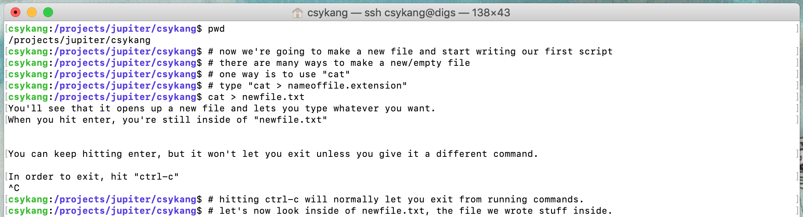
Making a new text file - cat

Slide 15
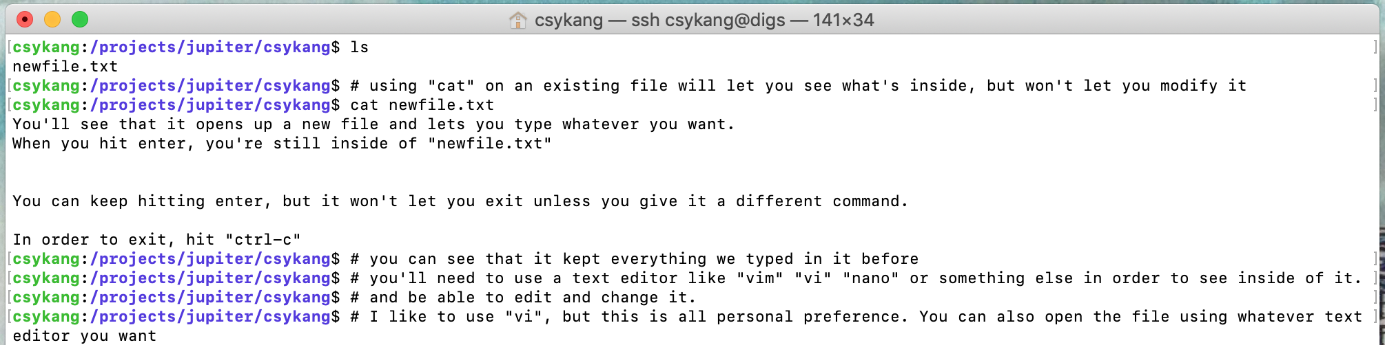
Making a new text file - cat
http://www.linfo.org/cat.html

Slide 16
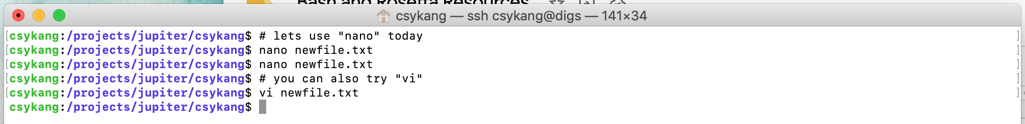
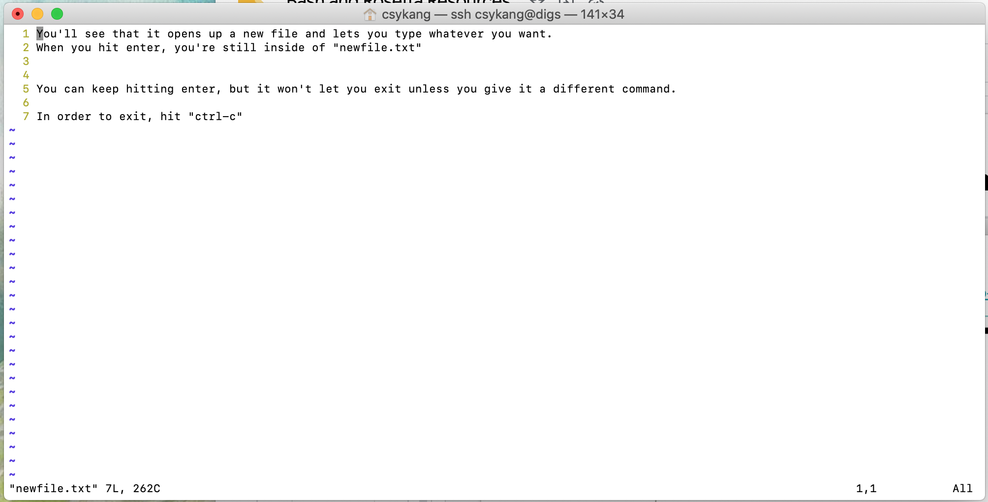
Editing a text file - vi
https://staff.washington.edu/rells/R110/

Slide 17
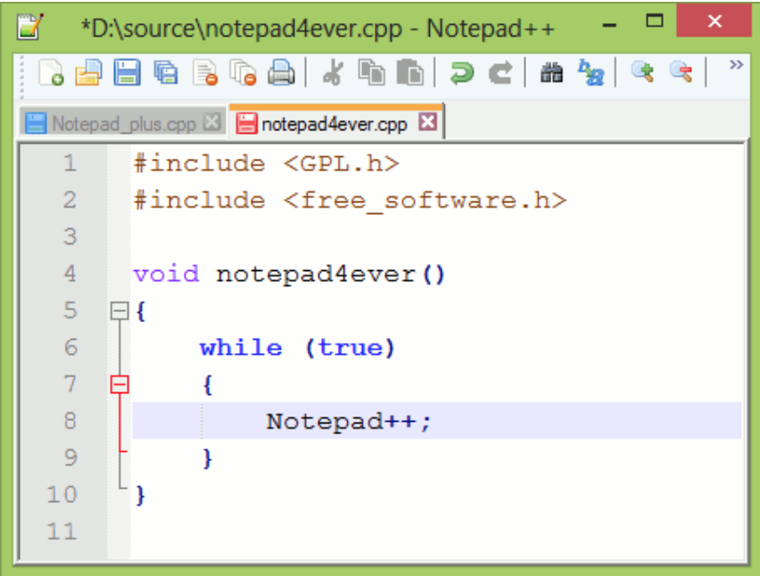
Editing a text file - Notepad++
For a more beautiful experience, you can download notepad++ (free):
https://notepad-plus-plus.org/downloads/
You may need to get more help from Patrick and Luki to mount the digs on your computer so you can open the files on Notepad++. More info here: https://my.ipd.uw.edu/kb/65
^You need to be logged into the VPN to access the 2nd link.

Slide 18
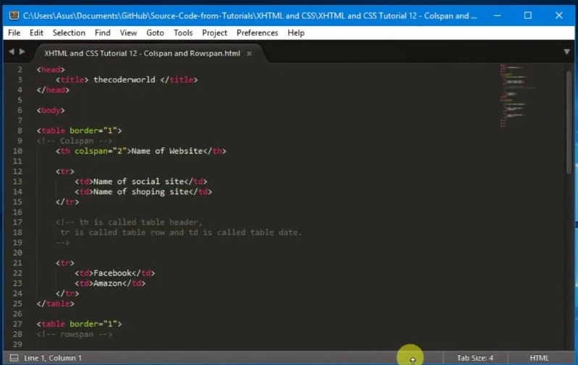
Editing a text file - Sublime
For an even more beautiful experience (and to look like a TV hacker), you can download Sublime:
https://www.sublimetext.com/
Just like with Notepad++, you may need to get more help from Patrick and Luki to mount the digs on your computer so you can open the files on Sublime. More info here: https://my.ipd.uw.edu/kb/65
^You need to be logged into the VPN to access the 2nd link.

Slide 19
Mounting the DIGs on your computer.
Tutorial
https://my.ipd.uw.edu/kb/65

Slide 20
Using Sublime.
Tutorial

Slide 21
Editing a text file - Sublime
For an even more beautiful experience (and to look like a TV hacker), you can download Sublime:
https://www.sublimetext.com/
There are a few ways to open files in Sublime:
Right-click on the file (e.g. in Finder) and open with Sublime
Open in your command line:
Mac
run myfile.txt #works if Sublime is default program for .txt files
open -a /Applications/Sublime\ Text.app myfile.txt
Windows
C:\Program Files\Sublime Text 3\sublime_text.exe myfile.txt

Slide 22
Homework
Office hours - please email one of us or post to the Mattermost channel to get help.
Mac Users: https://wiki.ipd.uw.edu/it/files/mounting
Get Sublime set up (slide 22) - reach out to us if you need help during an office hour.
Inside of your /projects/jupiter/yournetid directory (make sure you qlogin first), edit your example_skeleton_script.xml file using your text editor of choice to contain the skeleton xml format I linked in the previous slide.
You can find this skeleton XML script here: https://www.rosettacommons.org/docs/latest/scripting_documentation/RosettaScripts/RosettaScripts#skeleton-xml-format
You can read the links I put all throughout this slide deck to help you know which commands to use to navigate there, etc.
Whatever you haven’t yet done from the previous homeworks.

Slide 23
Bonus: are you tired of typing the same commands over and over again?
The alias command & .bashrc

Slide 24
Alias
Easy command for creating a new “shortcut” command
Usage:
alias newname=”full command to replace”
For example:
alias subl=”open -a /Applications/Sublime\ Text.app”
alias pymol=”open -a /Applications/PyMOL\ 2.app/”
alias digs_mnt="sshfs -o defer_permissions,follow_symlinks,reconnect,volname=digs,cache=no rdd48@share.ipd.uw.edu:/home/rdd48/ ~/digs”
alias digs_umnt="umount ~/digs"

Slide 25
Editing .bashrc
.bashrc is a file stored in your ~ directory with a series of commands that get auto-run every time you log in.
This is a great place to put alias commands!
To edit the .bashrc file:
cd ~
vi .bashrc
Type “i” (this puts you into “insert” mode)
Type your alias commands into the text editor
When finished, type:
Ctrl+C
:wq
Voila! Your changes should be saved. You can inspect this by running: cat .bashrc

